Slide 1
“Teach A Level Maths”
Statistics 1
Scaling and Coding
© Christine Crisp

Slide 2
Statistics 1
"Certain images and/or photos on this presentation are the copyrighted property of JupiterImages and are being used with permission under license. These images and/or photos may not be copied or downloaded without permission from JupiterImages"

Slide 3



We are going to look at the effect on the mean and standard deviation (s.d.) of adding or multiplying each item in a data set by a constant.
e.g. Consider the 3 sets of data below:
 | X | Y | Z
 | x | x+2 | 10x
 | 1 | 3 | 10
 | 2 | 4 | 20
 | 3 | 5 | 30
 | 4 | 6 | 40
 | 5 | 7 | 50
The mean and standard deviation of set X are given by
and

Slide 4


We are going to look at the effect on the mean and standard deviation (s.d.) of adding or multiplying each item in a data set by a constant.
e.g. Consider the 3 sets of data below:
 | X | Y | Z
 | x | x+2 | 10x
 | 1 | 3 | 10
 | 2 | 4 | 20
 | 3 | 5 | 30
 | 4 | 6 | 40
 | 5 | 7 | 50
mean
s.d.
The mean and standard deviation of set X are given by
and
Without working them out, can you see how the mean and s.d. of each of sets Y and Z are related to those of set X?

Slide 5


We are going to look at the effect on the mean and standard deviation (s.d.) of adding or multiplying each item in a data set by a constant.
e.g. Consider the 3 sets of data below:
 | X | Y | Z
 | x | x+2 | 10x
 | 1 | 3 | 10
 | 2 | 4 | 20
 | 3 | 5 | 30
 | 4 | 6 | 40
 | 5 | 7 | 50
mean
s.d.
The mean and standard deviation of set X are given by
and
The mean of Set Y is increased by 2 but the s.d. is unchanged since the data are no more spread out than before.

Slide 6


We are going to look at the effect on the mean and standard deviation (s.d.) of adding or multiplying each item in a data set by a constant.
e.g. Consider the 3 sets of data below:
 | X | Y | Z
 | x | x+2 | 10x
 | 1 | 3 | 10
 | 2 | 4 | 20
 | 3 | 5 | 30
 | 4 | 6 | 40
 | 5 | 7 | 50
mean
s.d.
The mean and standard deviation of set X are given by
and
The mean and s.d. of Set Z are each multiplied by 10.

Slide 7
So, adding 2 to each data item adds 2 to the mean but doesn’t change the s.d.
( Increasing all the data items by 2 doesn’t spread them out any more. )
Multiplying by 10 multiplies both the mean and the standard deviation by 10.
Suppose we multiply and add:
e.g.
x
1
2
3
4
5
10x+2
12
22
32
42
52
N.B. This means multiply by 10 and then add 2.

Slide 8
So, adding 2 to each data item adds 2 to the mean but doesn’t change the s.d.
( Increasing all the data items by 2 doesn’t spread them out any more. )
Multiplying by 10 multiplies both the mean and the standard deviation by 10.
Suppose we multiply and add:
e.g.
mean
s.d.
x
1
2
3
4
5
10x+2
12
22
32
42
52
N.B. This means multiply by 10 and then add 2.

Slide 9




So, adding 2 to each data item adds 2 to the mean but doesn’t change the s.d.
( Increasing all the data items by 2 doesn’t spread them out any more. )
Multiplying by 10 multiplies both the mean and the standard deviation by 10.
Suppose we multiply and add:
e.g.
 |  |  |  |  |  | mean | s.d.
x | 1 | 2 | 3 | 4 | 5
10x+2 | 12 | 22 | 32 | 42 | 52
N.B. This means multiply by 10 and then add 2.

Slide 10


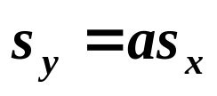



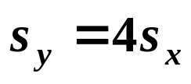


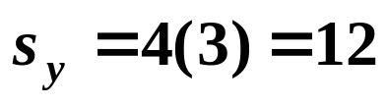
In general, we can write the results as follows:
If
then and
Adding a constant to all items of data does not alter the standard deviation.
e.g.1 A set of data has a mean of 8 and a standard deviation of 3. If the data are coded using the formula
where x is the original variable and y is the new variable, find the new mean and standard deviation.
Solution:
and
So,
and

Slide 11




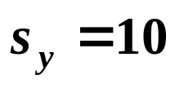







e.g.2 A set of exam results have a mean of 36 and standard deviation of 8. They are to be coded so that the mean is 50 and the standard deviation is 10.
What formula must be applied to each data item?
What does an original mark of 72 become?
Solution:
(a) Let x represent an original mark and y the new coded mark.
Then,
where
and
So,
Also,
where
and
So,
Solving equation (2),
Substituting in (1),
The formula is

Slide 12


e.g.2 A set of exam results have a mean of 36 and standard deviation of 8. They are to be coded so that the mean is 50 and the standard deviation is 10.
What formula must be applied to each data item?
What does an original mark of 72 become?
Solution:
The formula is
(b) Substitute x = 72 in

Slide 13

Exercise
1. The mean age of 5 children is 11·3 years. The standard deviation of their ages is 4·1 years. What will be the values of the mean and standard deviation in one year?
2. A set of data given by x is scaled using the formula
Find the values of a and b if the mean of 2·45 is scaled to 0 and the standard deviation of 0·97 is scaled to 1.

Slide 14


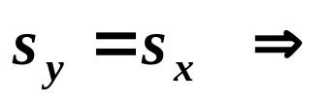
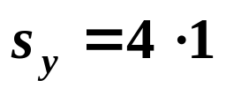
Solutions:
1. The mean age of 5 children is 11·3 years. The standard deviation of their ages is 4·1 years. What will be the values of the mean and standard deviation in one year?

Slide 15



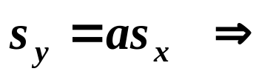





2. A set of data given by x is scaled using the formula
Find the values of a and b if the mean of 2·45 is scaled to 0 and the standard deviation of 0·97 is scaled to 1.
Solution:
and
Solving equation (2),
Substituting in (1),
The formula is

Slide 16


Slide 17
The following slides contain repeats of information on earlier slides, shown without colour, so that they can be printed and photocopied.
For most purposes the slides can be printed as “Handouts” with up to 6 slides per sheet.

Slide 18
The data set X has been modified to give sets Y and Z.
The mean and standard deviation of set X are given by
X
Y
Z
x
x+2
10x
1
3
10
2
4
20
and
3
5
30
The mean of Set Y is increased by 2 but the s.d. is unchanged since the data are not spread out more than before.
4
6
40
5
7
50
mean
3
s.d.
1·41
1·41
14·1
The mean and s.d. of Set Z are each multiplied by 10.

Slide 19
So, adding 2 to each data item adds 2 to the mean but doesn’t change the s.d.
( Increasing all the data items by 2 doesn’t spread them out any more. )
Multiplying by 10 multiplies both the mean and the standard deviation by 10.
Suppose we multiply and add:
e.g.
mean
s.d.
x
1
2
3
4
5
3
1·41
10x+2
12
22
32
42
52
32
14·1
N.B. This means multiply by 10 and then add 2.

Slide 20
In general, we can write the results as follows:
If
then and
Adding a constant to all items of data does not alter the standard deviation.
e.g.1 A set of data has a mean of 8 and a standard deviation of 3. If the data are coded using the formula
where x is the original variable and y is the new variable, find the new mean and standard deviation.
Solution:
and
So,
and

Slide 21

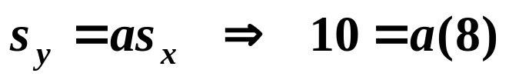

e.g.2 A set of exam results have a mean of 36 and standard deviation of 8. They are to be coded so that the mean is 50 and the standard deviation is 10.
What formula must be applied to each data item?
What does an original mark of 72 become?
Solution:
(a) Let x represent an original item and y the new coded value.
Then,
Solving equation (2),
Substituting in (1),
The formula is
(b) Substitute x = 72 in

